Slide 1
Vocal Replacement of Audio Recordings
Dao Vang
github.com/dao-v/Vocal_Replacement_of_Audio_Recordings
5/12/2020

Slide 2
Table of Contents
Project Goal
Background Information on Sound and Audio Files
Data Gathering
Data Preprocessing – Speaker Recordings
Data Preprocessing – Vocal Profiles
Deep Learning Model
Results
Conclusion

Slide 3
Project Goal
To extract the audio properties of the user’s recordings
Using Deep Learning, predict a new audio file with the user’s voice replaced with a speaker’s voice who was used in the training process

Slide 4
Sound & Audio Files
When perceiving sound, we are interpreting the vibrations in the air molecules
When computationally interpreting sound, small clips of sound are saved as Samples, which is like the term Frames when recording video
When converted from machine-readable files to human-readable NumPy arrays, the audio file contains information on:
Number of audio channels (stereo or mono)
Sample rate (number of samples per second)
Length of the audio recording
Total amplitude for a sample

Slide 5
Audio Channels
When converted to NumPy arrays, the dimension of the arrays informs the programmer how many audio channels the audio file contains:
Stereo track audio files have a NumPy array dimension of (X, 2)
X = Total number of samples in the audio file
Mono track audio files have a NumPy array dimension of (X, 1)
In this project, only audio files that are mono were used because vocal recordings in industry are typically recorded in mono

Slide 6
Sample Rate & Duration of Audio Files
Sample Rates are defined as the number of samples in each second of an audio file
Videos are recorded in Frames Per Second (FPS), which means that if a video was recorded with 60 FPS, there are 60 sequential images per second recorded
Even though the human eye can theoretically perceive an infinite number of frames, many people do not notice changes in the video quality when increasing above 60 FPS
Using the same concept, audio files are recorded in the same method
Sample rates can be represented as 44100 samples per second or as 44100 Hz
In this project, all audio files used had a sample rate of 16000 Hz
The Length of an audio file can be determined by simple mathematics:
Length (in seconds) = Total Number of Samples / Sample Rate

Slide 7
Amplitude
Audio files are typically loaded in as NumPy arrays in Python, where each array element represents one sample with the value representing the amplitude
A sample amplitude is the height of the net soundwave at a specific time point
The net soundwave means the sum of all soundwaves present
If two people were talking, then the net soundwave is the summation of the soundwaves being created by the two people

Slide 8
Data Gathering
All data used in training the model was obtained from: http://www.openslr.org/12/
Only the datasets labelled with “clean” was used
This dataset contained audio recordings with speakers reading various texts from books and other sources with a good ratio of female and male speakers

Slide 9

Data Preprocessing – Speaker Recordings
To extract the audio properties of the dataset, pyAudioAnalysis was used to streamline the process for every sample
The features extracted are depicted in the table, which was copied from the pyAudioAnalysis wiki page: github.com/tyiannak/pyAudioAnalysis/wiki/3.-Feature-Extraction
Feature ID | Feature Name | Description
1 | Zero Crossing Rate | The rate of sign-changes of the signal during the duration of a particular frame.
2 | Energy | The sum of squares of the signal values, normalized by the respective frame length.
3 | Entropy of Energy | The entropy of sub-frames' normalized energies. It can be interpreted as a measure of abrupt changes.
4 | Spectral Centroid | The center of gravity of the spectrum.
5 | Spectral Spread | The second central moment of the spectrum.
6 | Spectral Entropy | Entropy of the normalized spectral energies for a set of sub-frames.
7 | Spectral Flux | The squared difference between the normalized magnitudes of the spectra of the two successive frames.
8 | Spectral Rolloff | The frequency below which 90% of the magnitude distribution of the spectrum is concentrated.
9-21 | MFCCs | Mel Frequency Cepstral Coefficients form a cepstral representation where the frequency bands are not linear but distributed according to the mel-scale.
22-33 | Chroma Vector | A 12-element representation of the spectral energy where the bins represent the 12 equal-tempered pitch classes of western-type music (semitone spacing).
34 | Chroma Deviation | The standard deviation of the 12 chroma coefficients.

Slide 10
Data Preprocessing – Vocal Profiles
A vocal profile was created for every speaker, which contained the information based on the amplitudes in all the recordings associated to the speaker:
Minimum amplitude value
Maximum amplitude value
Mean amplitude value
Median amplitude value
Standard deviation

Slide 11
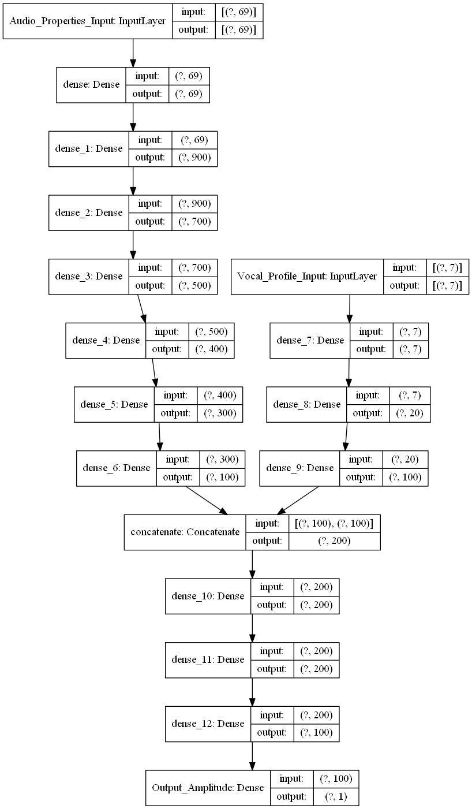
Deep Learning Model
TensorFlow/Keras API was used to implement deep learning
The model takes two inputs:
Speaker Vocal Profile
Audio Properties of the Recordings
Then the model merges the two pathways to produce one output, a predicted amplitude value
This was expected to mimic reverse engineering from audio properties to amplitude
The number of hidden layers and nodes were ideally set to provide flexibility in the learning process as amplitude values are a large range

Slide 12

Results
Predicting the amplitude values using a vocal recording reading “Fire and Ice” by Robert Frost as the audio properties input and the vocal profile of speaker 61 from the test-clean.tar.gz dataset resulted in a distorted audio file with faint hints a voice:
Predicted Audio File:
Original Audio File:
Speaker’s Voice:

Slide 13
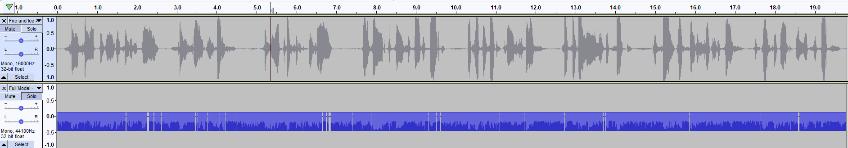
Results
Examining the waveforms in Audacity:
The top track is the original recording and the bottom track is the predicted recording after normalizing
The model was not able to predict silence (zero amplitude)
Predicted silence in samples where there were high amplitude values in the original

Slide 14
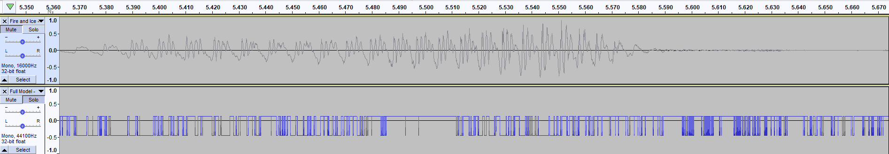
Results
Zooming in, the model seemed to mostly predict two main values at the minimum and maximum
The shape of the predicted waveform did not represent the shape of typical audio waveforms

Slide 15
Conclusion
Although the model failed to produce the expected outcome, there was a faint voice-like sound that could be heard sporadically indicating that the approach could work after adjustments to the data and model
If re-approaching the goal of this project, this project can serve as starting point on how to design a new approach

